Slide 1
Determinants of Credit Card Acceptance Among IronBank Customers:
An In-depth Analysis
Giorgio Lupo

Slide 2
Summary
Introduction
Dataset Overview
Models
Model Selection
Results
Business Takeaways

Slide 3
Introduction
Credit card services that are a very important source of revenue for the bank
What is the standard customer accepting credit cards offer?
Focused marketing study, with 18,000 current bank customers

Slide 4
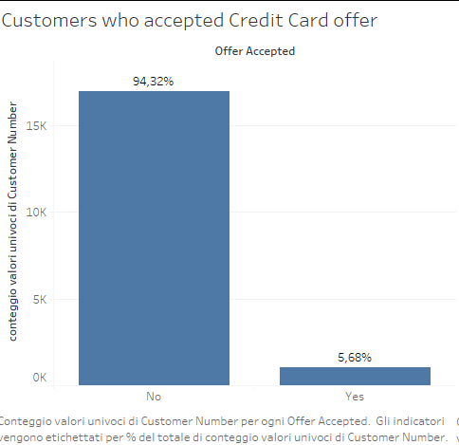

Slide 5
Dataset Overview
18K customers
Customer Number: Number assigned to the customers
Offer Accepted: Did the customer accept (Yes) or reject (No) the offer
Reward: The type of reward program offered for the card
Mailer Type: Letter or postcard
Income Level: Low, Medium, or High
Bank Accounts Open: How many non-credit-card accounts are held by the customer
Overdraft Protection: Does the customer have overdraft protection
Credit Rating: Low, Medium, or High
Credit Cards Held: The number of credit cards held at the bank
Homes Owned: The number of homes owned by the customer
Household Size: The number of individuals in the family
Own Your Home: Does the customer own their home? (Yes or No)
Average Balance: Average account balance (across all accounts over time)
Q1, Q2, Q3, Q4 Balance: The average balance for each quarter in the last year

Slide 6
Models
Random Forest: ensemble model that combines multiple decision trees to enhance prediction accuracy and identify significant patterns
Knn Regressor: predicts outcomes based on the average of similar neighbors' values. It's used to reveal trends among customers with comparable attributes
Linear Regression: establishes relationships between variables through a linear equation
Notes:
Random Forest: Random Forest is an ensemble model that combines multiple decision trees to enhance prediction accuracy and identify significant patterns. It excels in uncovering complex relationships and interactions within data, making it valuable for understanding the factors influencing credit card acceptance among IronBank customers.
K-Nearest Neighbors (KNN) Regressor: KNN Regressor predicts outcomes based on the average of similar neighbors' values. It's used to reveal trends among customers with comparable attributes, shedding light on whether customers sharing characteristics tend to accept credit card offers.
Linear Regressor: Linear Regression establishes relationships between variables through a linear equation. In the context of credit card acceptance, it provides insights into how individual attributes impact the decision, aiding in understanding the significance of each feature among IronBank customers.

Slide 7
Model Selection
Random Forest
Accuracy: 0.95
Knn Regressor
Accuracy: 0.95
Linear Regression:
Accuracy: 0.95

Slide 8
Model Selection
Random Forest
Accuracy: 0.95
Knn Regressor
Accuracy: 0.95
Linear Regression:
Accuracy: 0.95

Slide 9
Results
Credit Rating (+)
Customers with a low credit rating are more likely to accept the offer
Income Level (+)
Customers with lower income levels are more likely to accept the offer
Mailer Type_Postcard (+)
Customers who received postcards are more likely to accept the offer
Credit Rating_Medium (+)
Customers with a medium credit rating are more likely to accept the offer
Reward_Cash Back (-)
Customers offered cash back rewards are less likely to accept the offer
Income Level_Medium (+)
Customers with medium income levels are more likely to accept the offer
Reward_Points (-)
Customers offered reward points are less likely to accept the offer

Slide 10
Business Takeaways
Segmented Marketing Campaigns:
Develop tailored campaigns with financial products that suit Low credit rating and Low income customers
Focus on postcard mailers
Revamp Rewards Programs:
Reevaluate the "Cash Back" and "Reward Points" programs.
Personalize reward offerings based on customer segments
Education and Outreach:
Address concerns about high balances and overdraft protection in Q1 and Q3
Targeted Property Ownership Offers:
Develop offers tailored to renters or smaller households

Slide 11
Thank you

